Slide 1
COMPUTER HARDWARE REPAIRS AND MAINTENANCE

Slide 2
Objectives
Knowledge of Computer Hardware
Identify computer hardware Issues/Problems determine faulty Computer hardware
Know Basic computer troubleshooting tips Knowledge of Operating System and device Drivers
Identify hardware Peripherals
Basic knowledge of safeguarding hardware
Apply the knowledge to repair/maintain a computer.

Slide 3
Learning the COMPUTER Basics

Slide 4
What is a Computer?
An electronic device, operating under the control of instructions stored in its own memory, that can:
– Accept data (input)
– Process the data according to specified rules (process)
– Produce results (output)
– Store the results (storage) for future use.

Slide 5
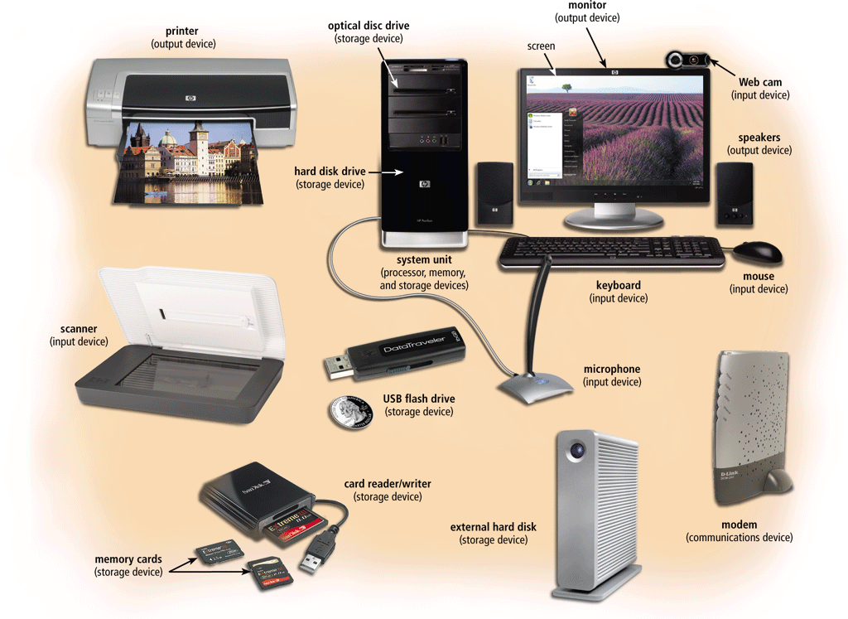
What is a Computer?...

Slide 6
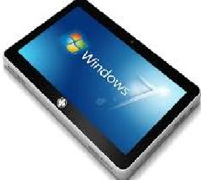
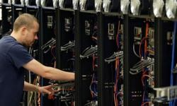
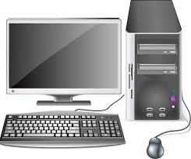
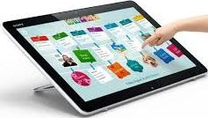
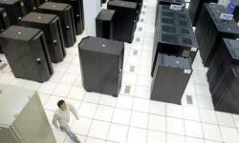
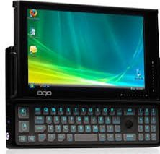
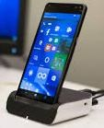
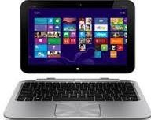
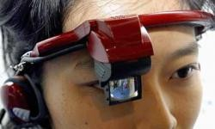
Examples and type of computer
Desktop
Tablet
Mainframe
Supercomputers
PDA
Smartphone
Notebook
Wearable Computers

Slide 7

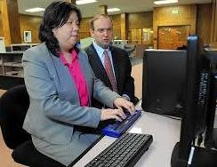

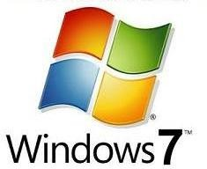
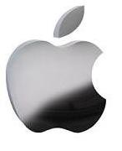
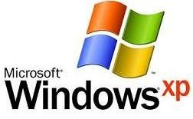
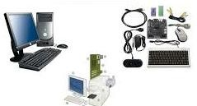
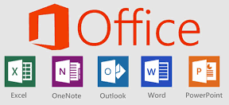
Computer System is functional only if :
Hardware
users
Software

Slide 8
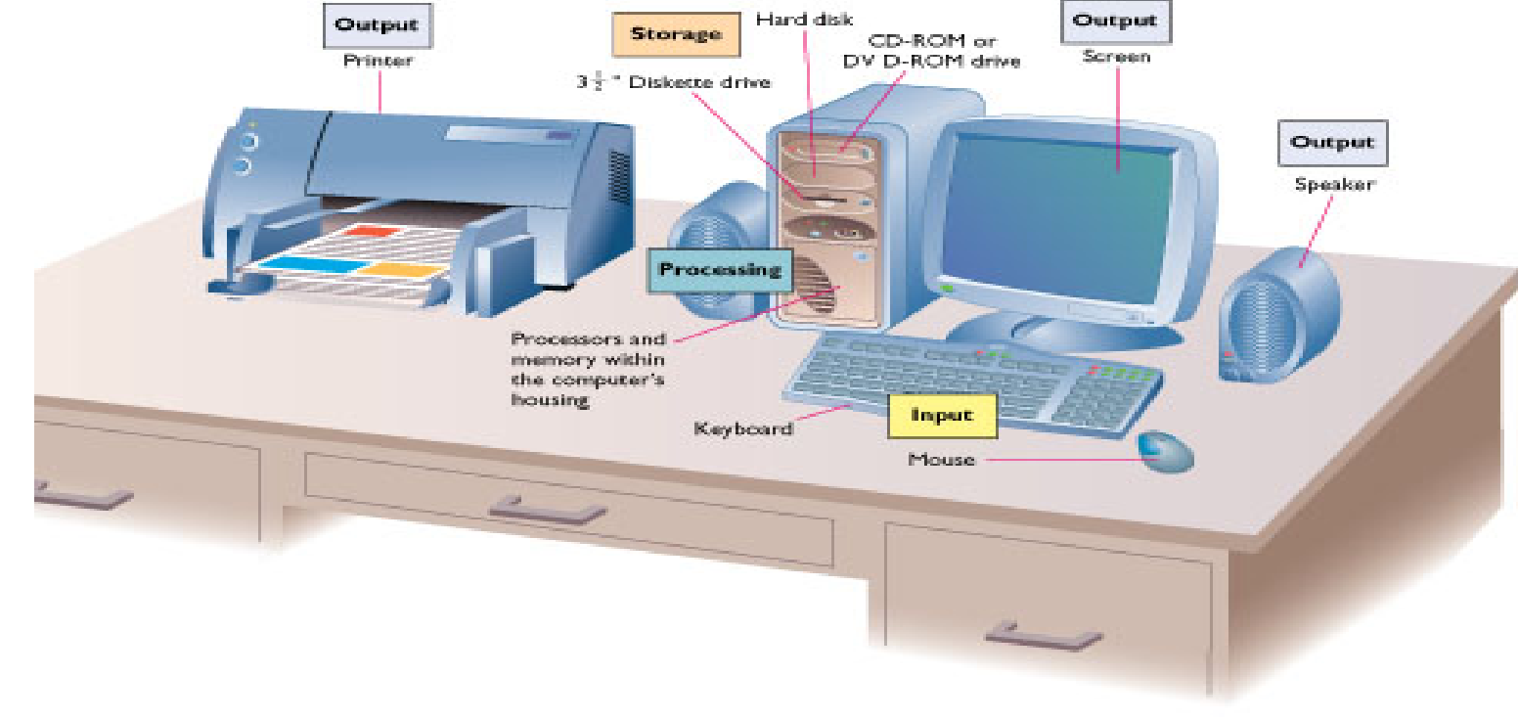
Hardware represents the physical and tangible components of a computer i.e. the components that can be seen and touched.
Examples of Hardware are following:
Basic Hardware components
Input devices: keyboard, mouse etc.
Output divices: printer, monitor, speaker etc. Secondary storage devices: Hard disk, CD, DVD etc. Internal components: CPU, motherboard, RAM etc.

Slide 9
Computer Hardware

Slide 10

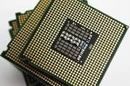

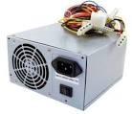
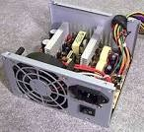
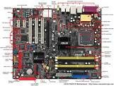
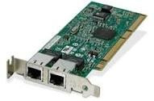
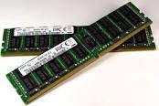

Hardware Components
Power Supply or SMPS(Switched Mode Power Supply). Converts AC voltage from the wall outlet to DC voltage the computer can use. It supplies DC voltages for internal computer components and has a fan to keep the computer cool.
Processor & Fan. The processor is the main “brain” of a computer system while the Fan help to prevent overheating of the various electronic components
Case/ System Unit. The computer case (also called a tower ) is the box that encloses many of the parts/components of the computer
Motherboard. The motherboard is a large electronic board that is used to connect the power supply to various other electronic parts, and to hold these parts in place on the computer.
RAM (Random Access Memory
short term memory that is used to store documents while they are being processed.
The amount of RAM in a computer determine the speed of a computer.
RAM attaches to the motherboard via some specific slots.
NIC (Network Interface Card) used to describe tools that allow your computer to connect and communicate with various input and output devices.

Slide 11
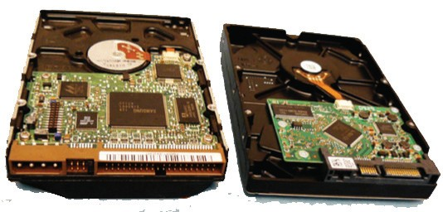
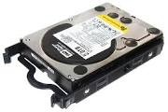
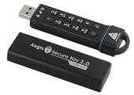
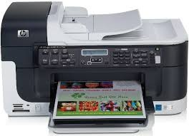
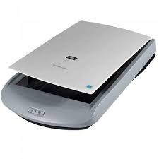
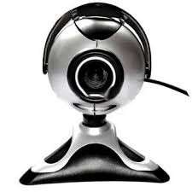
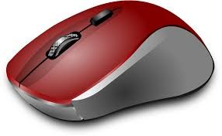
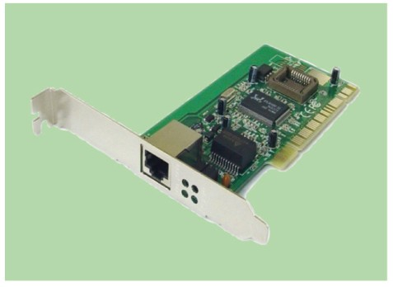
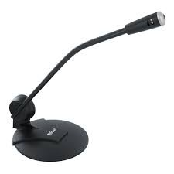
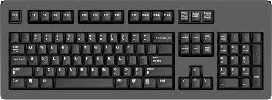
Hardware Components cont…
Computer Hard disk are of two types, IDE(Integrated drive electronics)-
Has a ribbon like cable with either a 40-pin or 80-pin connector.
The IDE data transfer interface runs in parallel.
SATA(Serial Advanced Technology Attachment)-
has a narrower cable with a split data and power connections.
It has a 7-pin cable and a much faster data transfer rate.
Most motherboards now support SATA
Well know hard disk manufactures are Seagate, Western
Digital etc.
Drives.
A computer’s drives are the devices used for long term storage of information. e.g. Hard Disk, Flash Disk etc.
hard drive - Or hard disk, is a common storage device for maintaining files inside the computer, usually mounted below or beside the ﬂoppy drive.
CD drive –
Holds disks (CDs) that have data,
music, or software applications.
DVD (Digital Versatile Disk) drive - Popular alternative to a CD drive that supports CDs as well as music and video DVDs.
Flash Drive-
Peripheral hardware.
Are the computer components that are not found within the computer case
It is deﬁned as any auxiliary device that connects to and works with the computer in some way. E.g. mouse, microphone and keyboard, monitor,
NIC(Network Interface Card)
(NIC) is a computer hardware component that allows a computer to connect to a network. NICs may be used for both wired and wireless connections.
A NIC is also known as a network interface controller (NIC) or network card, LAN card, network adapter or
network adapter card (NAC).
11

Slide 12
What is Computer Ports?
Port:
Is a connector on the motherboard or on a separate adapter that allows a device to connect to a computer; these may include keyboard, mouse, serial, parallel, network, sound, or video ports.
Ports vary with the type of equipment that connects to the ports.
Ports have gradually changed over time as computers have changed to become faster and easier to work with.

Slide 13
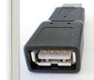
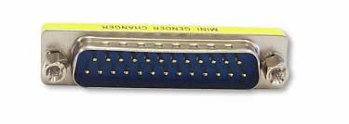
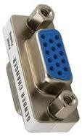

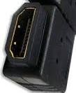
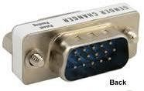
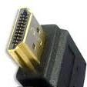

Port contd…
Male ports – Have pins that
Female ports.
Have holes in the connector to accept the male cable’s pins.
protrude out from the connector and require a cable with a female connector.

Slide 14
Ports…
D-shell connector – A connector with more pins or holes on the top row than on the bottom so that a connected cable can only be attached in one direction and not accidentally connected the wrong way; generally represented with the letters DB and the number of pins such as, DB-9, DB-15, or DB-25.
DIN connector – Round with small holes and normally keyed; the keyboard and mouse are usually this type of connector with either 5 or 6 pins.

Slide 15
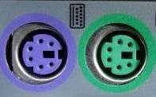

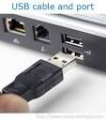


Parallel Port. (D-Shell Connector)
This long and slender port is also no longer commonly used,
The most common parallel port has holes for 25 pins,
Used for scanners and printers
Also called printer port
Serial Port. D- Shell Connector
uses pin connectors,
Also known as a COM port) can be a 9-pin Female D-shell connector
Data travels at 115 kilobits per second
PS/2. DIN Connectors
Most desktop computers have two of these round ports for six pin connectors, one for the mouse and one for the keyboard.
TRS. TRS (tip, ring and sleeve) ports Also known as ports for mini-jacks or audio jacks.
They are commonly used to connect audio devices such as headphones and
microphones to computers.
HDMI (High Definition Multimedia Interface)
provides an interface between any audio/video source, e.g. DVD player, or A/V receiver and an audio and/or video monitor, such as a digital television
(DTV),
HDMI supports standard, enhanced, or high-definition video, plus multi- channel digital audio on a single cable.
USB.
A 4-wire connector type of port
Diﬀerent models (USB 1.0, USB 2.0 and USB 3.0),
Connect all kinds of external USB
devices e.g. external hard disk, printer, scanner, mouse, keyboard etc.
Most of the computers provide two USB or three USB ports as minimum.
Data travels at 12 megabits per seconds
USB compliant devices can get power from a USB port
GAME PORT.D-Shell Connector.
A 15 port pin used to connect games

Slide 16
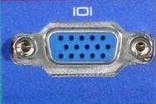
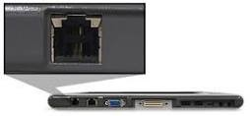
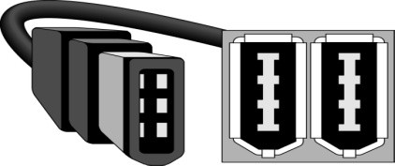

VGA
A three row,
15-pin female D-shell connector for newer VGA, SVGA, XGA, SXGA, or UXGA monitors
Connects monitor to a computer's video card.
Similar to serial port connector but serial port connector has pins, it has holes.
Modem Port
Connects a PC's modem to the telephone network.
Game Port.
Connect a joystick to a PC
Now replaced by USB
IEEE 1394 ports –
A serial technology developed by Apple Computer sometimes called the FireWire port.
A 6-wire cable/port (4 for data, 2 for
power)
speeds of 100, 200, 400, 800, and
1200 Mbps.
Ethernet Port
Connects to a network and high speed Internet.
Connect network cable to a computer.
This port resides on an Ethernet Card.
Data travels at 10 megabits to 1000 megabits per seconds depending upon the network bandwidth.
Serial Port. Male D- Shell Connector
uses pin connectors,
it is no longer commonly used,
It was used for printers, mice, modems and a variety of other digital
devices.
Data travels at 115 kilobits per second

Slide 17
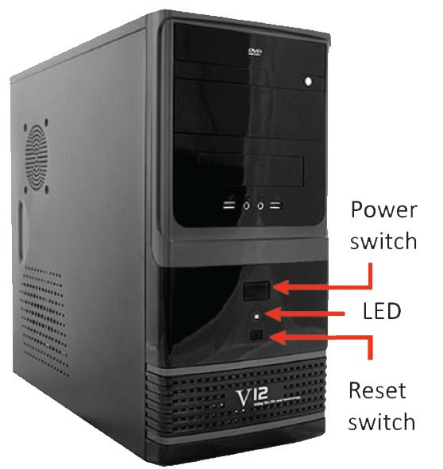
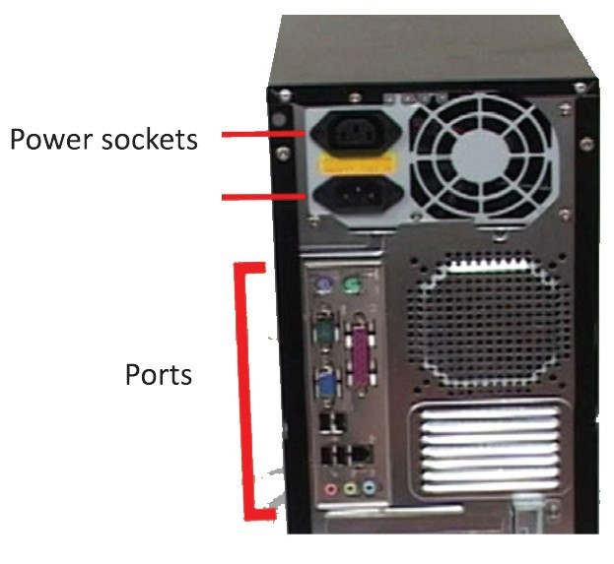
Arrangement of computer Components/ Ports

Slide 18
Computer Software

Slide 19
What is a Software?
Software.
Is a set of programs, which is designed to perform a well- defined function. A Program is a sequence of instructions written to solve a particular problem.
Types of software
System Software
The system software is collection of programs designed to operate, control, and extend the processing capabilities of the computer itself.
System software are generally prepared by computer manufactures.
System software serves as the interface between hardware and the end users. e.g. Operating System, Compilers, Interpreter, Assemblers etc.

Slide 20
Application Software:
Software Types and Categories…
Application software products are designed to satisfy a particular need of a particular environment.
Application software may consist of a single program, such as a Microsoft's notepad for writing and editing simple text.
It may also consist of a collection of programs, often called a software package, which work together to accomplish a task, such as a spreadsheet package. e.g. Payroll Software, Student Record Software , Inventory Management Software, Microsoft Office Suite Software, Adobe Premiere suites etc.
Utility Software. Allow a computer to perform tasks that are not part of the operating system, but are still practical and useful. For example, a utility software might instruct a computer on how to copy (burn) information to a CD-ROM disk, or it might be an anti-virus program

Slide 21
Proprietary Software vs. Open Source Software
They are proprietary, which means that their use and modification are restricted.
They can be quite costly to buy licenses for.
they are not adaptable to meet local needs.
Some users, particularly in developing countries, illegally use unlicensed (also known as pirate) copies of this software.
This is legally unwise, and can also keep the user from accessing important software updates.
Users who cannot aﬀord proprietary software or prefer software that can be locally modified, can choose to use open source (often called free and open source or FOSS) software.
For most of the standard computer uses, an open source software option is available. E.g. Linux family of operating systems (which includes Ubuntu, and the OpenOffice.org productivity programs.
T h e S o u r c e F o r g e w e b s i t e (www.sourceforge.net) is a good resource for finding and downloading open source programs.

Slide 22

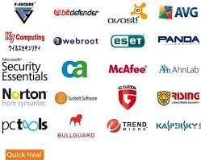


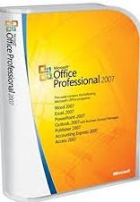

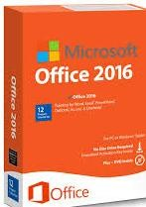
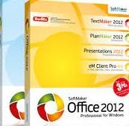

Examples and types of software
System Software: e.g.
Operating systems
System software: e.g. Utilities software
Application software: Microsoft Office suites
22

Slide 23
Relationship Between Hardware/ Software

Slide 24
Hardware and software are mutually dependent on each other. Both of them must work together to make a computer produce a useful output.
Relationship between Hardware and Software
Software cannot be utilized without supporting hardware.
Hardware without set of programs to operate upon cannot be utilized and is useless.
To get a particular job done on the computer, relevant software should be loaded into the hardware . i.e. a device driver is needed.
A device driver is a program that controls a particular type of device that is attached to your computer. There are device drivers for printers, displays, CD-ROM readers, diskette drives etc. When you buy an operating system, many device drivers are built into the product.
Hardware is a one-time expense.

Slide 25
Software development is very expensive and is a continuing expense.
Relationship between Hardware and Software
Different software applications can be loaded on a hardware to run different jobs.
A software acts as an interface between the user and the hardware.
If Hardware is the 'heart' of a computer system, then Software is its 'soul'. Both are complimentary to each other.

Slide 26
Identifying Computer Problems/Issues

Slide 27
Hardware or Software Problem ?

Slide 28
Tips for Distinguishing Between Hardware Problems and Software Problems…
Note: Make sure you reduce possible “external” problems before proceeding. This means unplug any external devices (such as hard drives, scanners or printers), and remove any USB Flash disk, CD or DVD disks from their drives.
Were there any loud noises or smoke when the problem first appeared? Then it is probably a hardware problem, with the most likely culprit being the SMPS(Switched Mode Power Supply )unit.

Slide 29
Tips for Distinguishing Between Hardware Problems and Software Problems…
Is the computer entirely dead? Or the screen blank? Or the screen showing a poor/incomplete picture? These faults are probably also due to hardware problems.
Does the computer produce a series of beeps? This is a code that can be used to distinguish some hardware problems.
Does the system give any error codes or descriptions while booting? These can be due to hardware or software problems. Take careful note of all information given in the error code.

Slide 30
Tips for Distinguishing Between Hardware Problems and Software Problems…
Does the computer produce error information after it has booted or only when you open specific programs? These error codes are probably due to software problems.
Have any recent changes been made to hardware or software (including BIOS settings)? If so, these are likely culprits.

Slide 31

Tips for Distinguishing Between Hardware Problems and Software Problems…
Has the computer been exposed to viruses or other malware? This could be a cause of software problems.
Use the Device Manager.
The Device Manager will list all of the hardware devices
installed on a PC. Any device with a problem will
have a warning symbol next to it, and double clicking on that device would give
details and suggested remedies for the problem.
Warning symbol
31

Slide 32
Computer Maintenance
NOTE: Prevention(maintenance) is better than cure(Repairs).

Slide 33
Computer maintenance is necessary…
Check harmful materials e.g. dust , virus, outdated software, faulty electrical Power/ gadget e.g. cables, sockets, extensions etc.
Check any malfunctions of peripherals.
Proper maintenance helps to keep the computer running smoothly for years.

Slide 34
Computer Maintenance…
Caution!!! •
These step are for the experience and professionals only!!

Slide 35
Dust Control.
Computer maintenance
Improving slow performance
Dust is very harmful for computer parts.
Excess dust can cause mechanical failures, particularly on computer components with moving parts.
Computers should be dusted regularly by using compressed air machines .

Slide 36


Computer maintenance: Improving slow performance
Disk Defragmenter.
Used to organize files on the hard drive and optimize free space, im pr ov ing t he spe e d a nd performance of the computer. Some applications may fail outright if the disk becomes too fragmented.
Scan Disk/ Check Now:
For hard disk faults, use scan disk/
Check now to scan the hard disk for faults and even repair them if possible. This option will check the Hard disk for errors.

Slide 37


Computer maintenance: improving slow performance
Excess and Unused Files.
Disk Cleanup:
The Disk Cleanup Utility can determine which files on your hard drive may no longer be needed and delete those files. In addition to freeing up potentially significant amounts of hard drive space. Using this utility regularly can improve system performance.
As a hard disk becomes full, the computer’s performance is reduced.
It takes more time to find and access needed files.
Defragmentation is not as successful due to a lack of free space to temporarily move files to while they are being rearranged .
Therefore, it is wise for a computer user not to keep files that are no longer needed.
Files that have been stored in a user’s documents folder that are no longer needed (such as extra photos or older versions of documents) should be deleted.

Slide 38

A typical example of a fully loaded Local Hard Disk drive

Slide 39
Deleting Browsing History.
Computer maintenance: Improving slow performance
The browser stores the recent history of the web pages that the user has viewed,
This make it easier to find and load these web pages again.
The browser also stores other small bits of information such as data entered into forms and usernames or passwords if a user has asked a web page to “remember me” (although this is not a good idea for shared computers).
This stored information can be easily deleted.

Slide 40
Startup folder
Computer maintenance: Improving slow performance
Some programs will automatically put a shortcut in the Startup folder, forcing the program to automatically launch when you turn the computer on or log in. Sometimes this is desirable, sometimes not. Either way, this practice may slow your computer down to various degrees, and with the program running all the time, may slow down the performance of your computer.
Delete some of the programs in the Startup folder

Slide 41
Computer maintenance: Improving slow performance
Software Inventory
Once the hard disk becomes full, a computer’s performance is reduced. To avoid installing software that are not necessary, system inventory will require you knowing what software is needed/wanted on your computer.
Note:
Please use caution when uninstalling software. In order to reinstall, you will need
the original software installation files.
41

Slide 42
Computer maintenance: Improving slow performance
Protect your PC from cyber-threats or Malware
The cyber-world is full of threats such as viruses, spyware, Trojans, Worms and etc. These cyber-threats can cause huge dilemmas to your computer. These undesirable programs, which are usually added without a user’s knowledge, can significantly slow down the performance of a computer.
The best ways to prevent virus infections are:
Keeping antivirus software up to date and running scans on a regular basis
Strict policies should be put in place to prevent virus infection e.g. prohibiting the use of ﬂash drives, or require Flash disk to be scanned before use.
Other policy to consider is the prohibition of downloading, since unsuspecting users can accidentally download malware.
A firewall may also be used to blocks dangerous downloads.

Slide 43
Computer maintenance: Improving slow performance
UPDATING SOFTWARE
It is important for a computer user to find and install software updates in order to have well performing computers.
Updating software can be done in a variety of ways, Automatic Updates, Automatic Alerts for Updates, Manual Updating, Oﬄine Updating.

Slide 44
Computer maintenance: Improving slow performance
Overheating
Excessive heat can cause a significant decrease in computer performance.
In order to cool down an overheated computer processor, avoid operating the computer if the case is in an enclosed space. (such as a drawer or cupboard).
Also cool the room with fans or air-conditioning.
Also verify that all of the fans in the computer case are functioning properly.
Note: Modern computers have safeguards that shut down the system if a component is overheating.

Slide 45
Computer maintenance: Improving slow performance
Insufficient RAM
Computer need sufficient RAM to perform the desired functions once the memory is not sufficient. The performance will be slow.
This problem is most likely if the computer is rather old and has had a newer (and more memory demanding) operating system installed.

Slide 46
Computer maintenance: Improving slow performance
Endurance:
Lastly, one important hint to also keep in mind when you are using a computer is to be patient. Sometimes the computer has to “think” too!(process)
Note:
Avoid opening too many programs at a time. It will reduce the performance of the computer.

Slide 47
HARDWARE REPAIRS

Slide 48
Hardware Repair
Repair means to rectify, to fix the problem either in the hardware or software. it may also include replacement of a component that is faulty.
It is an essential part of troubleshooting.
In finding or analyzing the faults, it can be decided which hardware or software can be repaired.

Slide 49
For repairing or trouble-shooting a computer use the following guidelines:
GENERAL GUIDELINES FOR REPAIRING COMPUTERS
Gather together your toolkit: e.g. air blowing machine, screw drivers, software, back up disk etc.
Check for power FIRST, before doing anything else.
10 - 15 percent of all computer Issues/Problems emanate from power surge. Check this BEFORE doing anything else. Check to be sure if the computer is plugged in to an AC outlet properly.
Check your external connections to the computer.
Specifically, check the mouse, keyboard, monitor, modem and/or printer cables, making sure that all are secure and in the right sockets.
Perform the Power On Self Test (POST)
POST is a set of procedures that a computer runs through each time it is turned on. It ensures that all of the system's hardware is working properly before trying to load the operating system. If the computer does not pass POST, it will not boot.
Tip: Make sure the computer turns on. If nothing happens (no lights, no sound, no fans, etc.), the computer has a power related issue.

Slide 50
GENERAL GUIDELINES FOR REPAIRING COMPUTERS
If the computer is still malfunctioning, go ahead then and open the case.
Check to see that all of the cards are fully pressed down into the bus connections, that any socketed chips are fully pressed into their sockets, and that all cable connections are fully attached. Make sure that the drive cables are attached correctly.
Clean any dust or foreign material out of the case while it is open.
Dust can cause overheating problems and electrical shorts. Sometimes, insects will nest inside the case as well. All of this needs to be cleaned out before you close up the case. Take precautions to avoid inhaling excess dust, and consider using protective eyeware if necessary.

Slide 51
GENERAL GUIDELINES FOR REPAIRING COMPUTERS
Try to boot the computer to the hard drive, or to a bootable CD/DVD disk if necessary.
Sometimes the hard disk will become corrupted by a user, or by a virus.
Check the CMOS setup program, and correct any conﬁguration problems.
If the information in CMOS RAM about your PC's configuration has been changed, or if the battery has died, your computer will not boot correctly, or it will not recognize certain components.
Look for unwanted changes.
Someone may have turned the brightness down on a monitor, or the LAN staﬀ may have changed your PC's configuration without your knowledge (or approval), or an installation program may have corrupted your software. Look for recent changes in your system's operation. You may need to run an uninstaller program to remedy software-related problems.
Isolate the problem to one piece of hardware, or one software package.
When all these fails, then consult a professional.

Slide 52
The computer is unable to start up – If the computer does not turn on when you press the power button, the following suggestions may help you to determine why the computer will not start up.
Computer issues/Problems and the tips to troubleshoot and fix/ repairs .
First of all, check if the computer is plugged in to an AC outlet properly.
Plug another electrical device into the outlet to be sure that the outlet is providing adequate power. A surge protector can be used in this case, because voltage surges can be very damaging to computers and other electrical components. Then put on the system to perform a POST .
After the POST and it is confirms that, the computer is producing all of the usual startup sounds and lights, but the monitor is not displaying any information, perhaps there is a problem with the monitor. Make sure that it is connected to a power source, and also that the VGA cable is connected to the computer.

Slide 53
Computer issues/Problems and the tips to troubleshoot and fix/ repairs ...
The computer screen is blank
If the screen is blank, the computer may not be set to display the image on the computer screen.
First, check if the monitor is plugged in to a power outlet and is connected to the computer securely and make sure the monitor power button is on.
If the power light is not on, it means that the outlet is not delivering power to the monitor. Fixing the power outlet in such cases should help solve the issue.

Slide 54
Computer issues/Problems and the tips to troubleshoot and fix/ repairs ...
The Blue screen-These errors are often caused by
Poorly functioning device drivers,
Hardware problems (such as memory, power supplies or system overheating),
Problems with the system software.
The option of System recovery and backup service will restore your PC to an earlier point of stage. You can perform this action whilst you get a Blue screen error or sudden system crashes.
NOTE: Backup service is an assurance that your data is safe.
Trouble with video card –
If the power light of the computer and monitor is on and nothing comes up on the screen when you start your computer then there must be something wrong with video card. Change its video or the graphics card with a new one.

Slide 55
Computer issues/Problems and the tips to troubleshoot and fix/ repairs ...
OS or some Software is functioning abnormally – If the Operating System (OS) or some other software is unresponsive or responds abnormally,
Immediate Solution: Restart your computer and run a virus scan.
Note: You should have a reliable antivirus software installed on the computer to fix this issue.
Windows do not boot properly – If windows do not boot properly then you should reinstall windows with the windows recovery disk. Most of the times, this should help you get rid of the problem.

Slide 56
Computer issues/Problems and the tips to troubleshoot and fix/ repairs ...
The computer is on but not responding – the computer is on but not responding to software or keyboard commands, then it must be frozen or halted.
Immediate solution:
Press and hold the power button for at least 5 seconds,
it will be turn oﬀ.
Now restart your computer. This should fix the problem.
An external device is not working – If an external device does not function as expected.
Immediate solution:
turn it on according to Manufacturers instruction;
be sure that all device connections are secure and receiving electrical power
Be sure the device is compatible with the operating system.
And that the correct drivers are installed and updated.

Slide 57
Problem/Issues
Power on the Computer
Troubleshooting Flowchart
Does a Cursor appear?
Troubleshoot Video
or Power Supply Problem
NO
Yes
Troubleshoot POST error
Does POST pass successfully
NO
Yes
Does a Computer boot successfully
?
Troubleshoot boot device, Operating System or Application loaded in the Startup folder.
NO
Yes
Computer HardEwnadre Repairs and Maintenance
57

Slide 58
Most common Basic computer Hardware Repairs
Replacing a Power Supply. The power supply failure is a common problem in our country. This is due to an uneven or “poor” voltage and power surges.
Replacing a Hard Drive or formatting and installing Fresh OPERATING SYSTEM.
Replacing RAM. RAM can fail or can loose from its housing and need to be reseated. If a computer needs new or additional RAM, it is important to make sure that the RAM used is compatible with the computer system. RAM is very easily damaged by electrostatic charges, so it is very important for the user to be grounded before picking up RAM. Also RAM should only be handled by the edges.

Slide 59
Peripheral hardware will also last longer if it is well maintained. Peripheral hardware such as printers, scanners will last longer if proper care about heat, dust and power surge control is taking to consideration.
Troubleshooting and ﬁxing Printer problems
Peripheral Hardware Use and Maintenance
Let’s assume that your printer’s drivers are up-to-date,
and that it has enough paper and ink or toner to print.
Try turning the printer oﬀ and on.
Unplug the printer and plug it back in.
Check your printer’s print queue by looking for the printer icon in the system tray and double-clicking it.
The print queue shows you the status of each job as well as the general status of your printer.
make sure that ‘Use Printer Oﬄine’ isn’t selected.
Ensure that ‘Use Printer Oﬄine’ isn’t checked.
Sometimes, printing while your printer is turned oﬀ can cause Windows to set your printer to work oﬄine, and that can stall jobs sent later.

Slide 60
MALWARE

Slide 61
Virus
Malicious software, is any software used to disrupt computer or mobile operations, gather sensitive information, gain access to private computer systems, or display unwanted advertising. These malicious software ﬁnd its way into:
Boot sector
File Allocation Table
Partition table
.Com and .Exe. Files.

Slide 62
Deadly eﬀect of virus
Delete files
Change files,
Steal important information,
load unwanted applications
Send documents via electronic mail (e-mail),
Cripple a machine’s Operating system (OS), the basic software that runs the computer.

Slide 63
Virus warning signs
The computer’s performance slows down considerably.
Programs don’t function as thy should. They either don’t start, or if they start, they stop or do not give the desired output.
Computer fails to boot.
Files and folders keep disappearing without anybody deleting them.
The computer crashes or freezes indiscriminately such as program not responding errors.
The computer keeps showing out –of -memory space messages or strange dialog boxes.
Programs and windows popping up randomly.
Disk can not be accessed
New icons and programs get installed automatically.
Printing doesn't work correctly
Windows shuts down or restarts unexpectedly.
A partition in the system disappears automatically.
File size changes for no apparent reason
An increase in the number of files on the system when nothing has been added.

Slide 64
A Good Virus Protection Program should:
Scan for viruses:
Should be able to check your drives for viruses, as well as the RAM of your computer, and detect the presence of a virus.
Clean up the virus:
must be able to get rid of the virus it finds on your computer; otherwise, it is useless.
Protect your System from viruses:
Must have the ability to load a piece of the program into memory at boot-up time, to protect you from getting a virus in the first place.
Provide Automatic updates,
Must regularly and automatically check back with the manufacturer for information on new viruses,

Slide 65
CONCLUSION: Best Practices and Dos and Don’ts
Always ensure that the power has been turned oﬀ before installing or troubleshooting any hardware part of the computer.
Before opening a computer case, always unplug the power cord from your computer.
After unplugging the power cord from your case, Hold the power button in for at least 5 seconds. This will drain any residual electricity from the power supply
Always ground yourself to the case frame while touching any inside components. This can be done by touching the case frame with your bare hand, or using a clamp-on grounding device made specifically for this purpose
Keep all liquids away.
Avoid installing components when the computer is in operation.
When installing any, peripheral or device, always read the installation instructions that come with the device. Never apply force to try and connect any plug/device.

Slide 66
CONCLUSION: Best Practices and Dos and Don’ts
When fitting/handling processor on motherboard always wear gloves
Always choose to shut down you computer by clicking shutdown. Avoid switching of the power directly from the main switch.
If electrical power is lost, switch oﬀ all computer devices from the mains to avoid any problems due to power surge.
Always “eject “USB devices from the operating system before disconnecting them.
Upgrade the anti-virus regularly.
Always use UPS(uninterruptible Power supply)-This will keep your computer from crashing during power outages, and will protect your computer from low and high voltage occurrences.
Uninstall software by
“Add / Remove Program” function in Control Panel
uninstall function of applications

Slide 67
CONCLUSION: Best Practices and Dos and Don’ts…
Back up data, if possible, before making changes.
Check to ensure that speakers is not muted through the Control Panel
Maintaining the Battery for your Laptop
Most laptop batteries will last at least four hours when fully charged. If not maintained, however, the battery will require charging more frequently. for maximum performance.
Use the battery as your power source until the low battery warning emerges.
Using your laptop with the AC adapter plugged into an electrical outlet will overcharge the battery. Overcharging decreases the life of the battery. Eventually the battery will be unable to hold a charge and will require a replacement.
Condition the battery for maximum performance
Discharge the battery – use the battery until the low battery warning emerges.
Charge the battery – use the AC adapter until the battery is fully charged.
Then immediately disconnect the AC adapter from the notebook. The procedure above insures both maximum performance and long life for the battery

Slide 68
Thank you and God Bless you all.

